Slide 1
Social Games Market in Russia
Edgars Strods
Head of gaming department, Odnoklassniki.ru
11.07.2012
Notes:
Hello everyone, as you can see – my name is Edgars Strods, and I am head of gaming department of one of the biggest social networks in Russia – Odnoklassniki.ru. In next 15-20 minutes I will tell you a bit more about social game market in Russia and Eastern Europe. Numbers, players, future – in next slides.

Slide 2
About Odnoklassniki.ru
32 mln daily active users *
Best social gaming network **
Offices in Riga, Moscow and Sankt-Petersburg
Liveinternet.ru
Appdata.ru
Notes:
First of all I would like to tell you a bit more about Odnoklassniki.ru
It is one of the biggest social networks in Russia and CIS countries. More than 30 mln daily active users and most successful gaming platform in the region. Right now we have 3 offices (two in Russia and main development office in Riga).

Slide 3
Content
Numbers
Games
Future
Notes:
So, these are the main topics I would like to tell you about. Key numbers about market, will take a look into games and developers and try to figure out about future.

Slide 4
Numbers – Games - Future
NUMBERS
Notes:
As you may know, Russian gaming market is growing very fast. In recent Mail.ru Games research report, growth is more than 25% annual. And major players are exactly social game developers.

Slide 5
Numbers – Games - Future
Market value, millions
2009 – 30$
2010 – 70$
2011 – 200$
2012E – 340$
http://www.vedomosti.ru/newspaper/article/2009/11/03/217983
J’Sons and Partners Consulting
Inside Virtual Goods 2009-2011
Notes:
I think it will be better if I will show you these numbers. Taking a step back in 2009 there was only one game called Lucky Farmer (or Shastlivij fermer) by ijet and small flash-games. When API opened in 2010 by mail.ru and Odnoklassniki – social applications became big part of russian game market. Each year these numbers doubled, and in the end of 2011 it was more than 200 million dollars. Even if 2012 is not so great in terms of growth because of uprising competition from mobile platforms like App Store or Android market, it is predicted more than 300 million dollar worth business.

Slide 6
Numbers – Games - Future
Social network audience, monthly
2009 – 25 mln
2010 – 37 mln
2011 – 54 mln
2012E – 70 mln
TNS
J’son & Partners Consulting
Notes:
Phenomenon of social networks is hard to underestimate. If earlier it was just a platform to to send a message to another person and share photos, now it is powerful instrument to share information. As you can see, right now more than 50mln people have at least one active account in social network. Leaders have more than 30 mln daily active users and growth is still very impressive.
And you know that if you aggregate so much people in one place – you have to find entertainment for them.

Slide 7
Numbers – Games - Future
Installs
 | 2009 |  | 2010 |  | 2011
i-Jet | 27* | Creara | 100 | Mail.ru | 154
Mail.ru | 17 | Mail.ru | 88 | API Tech | 95
Progrestar | 12.3 | i-Jet | 60 | Social Quantum | 73
Коктейль другу | 8 | Social Quantum | 33 | Plarium | 53
Holy Cow | 4.8 | Fish Sticks | 28 | Orange Apps | 45
* In millions
http://www.insocialplay.ru
Notes:
So, back to Lucky farmer. Everyone was playing Lucky Farmer. And every single news media associated social games only with farms. As we can see at dynamics - leaders changed a lot.

Slide 8
Numbers – Games - Future
Users
Одноклассники |  | Мой Мир |  | ВКонтакте
Новые земли | 1 300 000 | Любимая ферма | 250 000 | Запорожье | 560 000
Территория фермеров | 1 200 000 | Тюряга | 200 000 | Уличные гонки | 380 000
Запорожье | 760 000 | Новые земли | 198 000 | Правила войны | 340 000
Мегаполис | 700 000 | World Poker Club | 175 000 | Покер Shark | 300 000
Торговый квартал | 600 000 | Запорожье | 173 000 | Фармандия | 280 000
* Daily active users
http://www.appdata.ru
Notes:
But in my opinion, if we want to find out leaders, best measurement is DAU and monetization. And here situation is totally different. Not always great numbers of installs are converted to high DAU. Unfortunately Vkontakte.ru do not show all statistics, but anyway – we can find some companies like Social Quantum, Plarium, Mail.ru and new “star” – Crazy Panda being in leader status.

Slide 9
Numbers – Games - Future
GAMES
Notes:
I think it is enough about numbers, lets step ahead and take a look at competition, right?

Slide 10
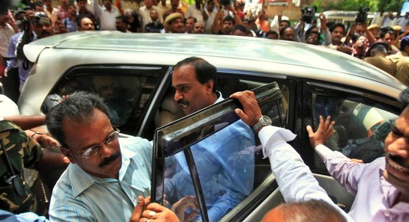
Numbers – Games - Future
More than 200 developers
Most of them – single title company
10% developers control 90% market
Notes:
There is more than 200 developers, but in most cases this is one-title only company. In many cases there are just two or three people in this so-called company. It is usual that after success next game is failure and then money is run-out and development stops. If we take into account earlier named numbers, market is controlled by just 15-20 companies.

Slide 11
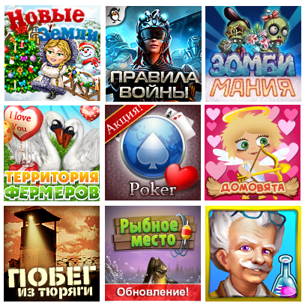
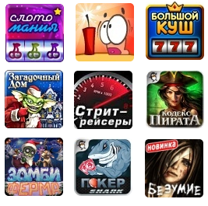
Numbers – Games - Future
Genres
All popular genres already in social networks
Tight competition in all categories
Farms still rules
Era of gambling
Notes:
RPG, MMO, strategy, casual hidden-object, even Sims is in social networks. There is no difference about platform on which game can be launched, it is just a matter of realization.
And yes – competition is great in every single genre. Farms are still growing, but the future is quite dark for pure farm-games. If you are developing farm game – it should be AAA-class game with huge believe in success and enormous budget for updates and advertising.
Gambling is growing fast, and top-grossing application on every platform is exactly this slot-machines or bingo, or casino-games.

Slide 12
Numbers – Games - Future
Clones
Lack of own ideas
Hopes getting rich fast
Failure to follow the trends
Notes:
Talking about clones – years of copy-cats passed. Companies, which choose to “get rich by stealing” already gone bankrupt. Every single clone is dedicated to failure just because developers do not understand why it was done this or another way and that is resulting in failure to follow trends.
And don’t forget about reputation – stolen game remains stolen, even if it is redesigned later.

Slide 13
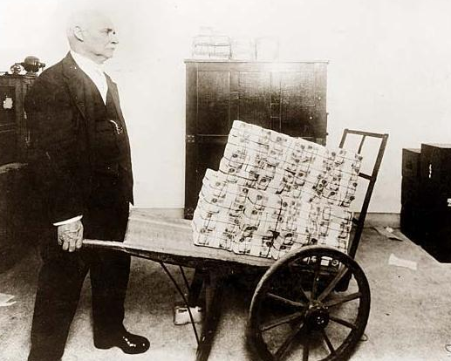
Numbers – Games - Future
Leaders
Low competition
Top-20 games earning enormous share
Difficult to compete
Notes:
Despite of great competition in terms of genres, there is a low competition between companies. In reality, there is no competition at all. Social Quantum, Crazy Panda, Plarium with best social strategy games – and that’s it.
Companies like Mail.ru have only one or two successful game on Moi Mir, gets nothing elsewhere. Same as Kefir – game “Prison”, Drimmi with game about fishing, Pixonic with Little Helper, Vizor Interactive with Zombie farm and so on.

Slide 14
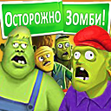
Numbers – Games - Future
Not only local
Everyone except Zynga
Missed opportunity
Global market
Notes:
Fast growing market is not only for East European developers – almost all of top developers from Facebook launched their games in Russia. But still there is a problem with understanding, that time of hardcore advertising and traffic generation has come.
In matters of months I am pretty sure that games will be launched in all social networks with short interval – launching game in russian or hindu or french is not more an extra, but vital part of success.

Slide 15
Numbers – Games - Future
FUTURE
Notes:
Well, taking into account all that I said before, will try to predict future trends for Easter European market

Slide 16
Numbers – Games - Future
Competition between social networks
Non-gaming applications
Е-commerce
Evolution of advertising
Mobile expansion
Notes:
New api methods, more effective viral channels, better documentation – this competition between social networks will rise again.
Advertising as key role for success, it is not enough to launch game and release new updates. You have to buy traffic, analyze every single movement and improve retention to achieve maximum.

Slide 17
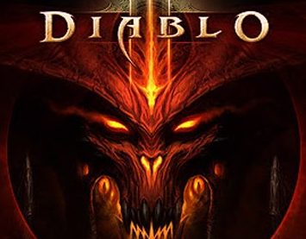
Numbers – Games - Future
Quality of games
Consolidation of players
PC-games in social

Slide 18
Thank you!
http://ok.ru/edgar http://dev.odnoklassniki.ru
12.07.2012

