Slide 1

The Art of Thinking Small
Learning to appreciate small games

Slide 2
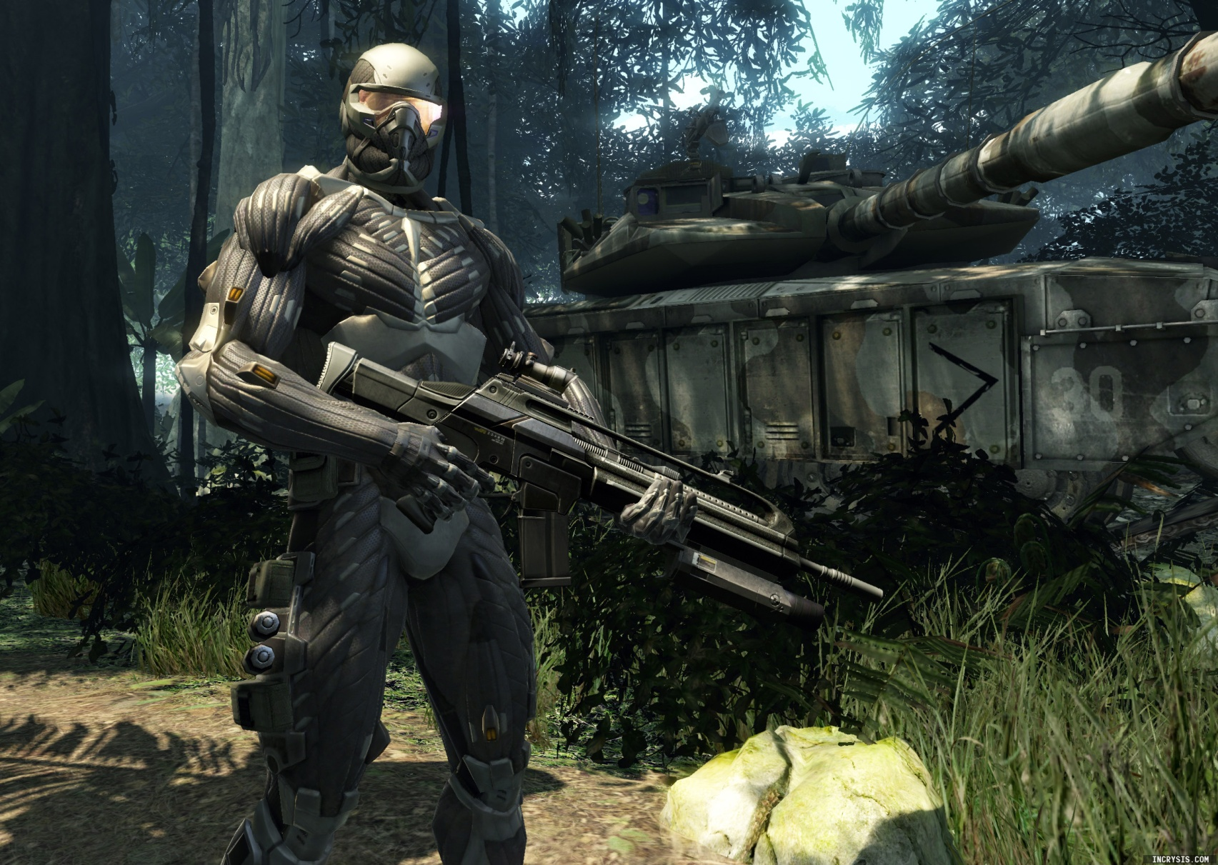
The vision

Slide 3
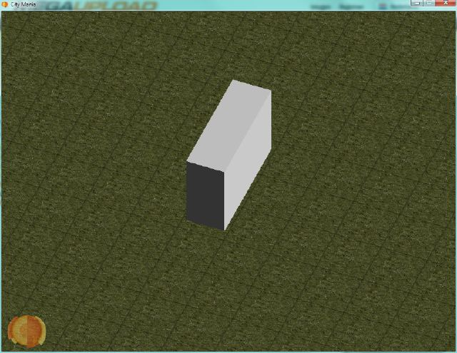
The result

Slide 4
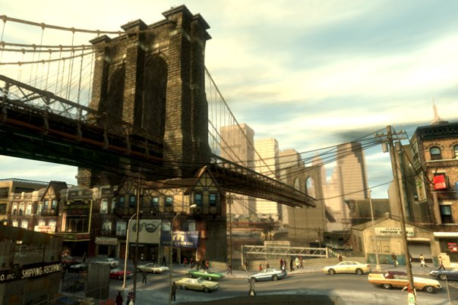
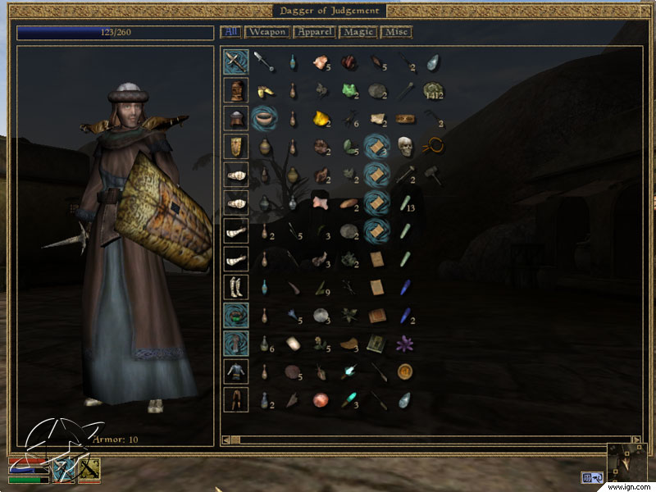
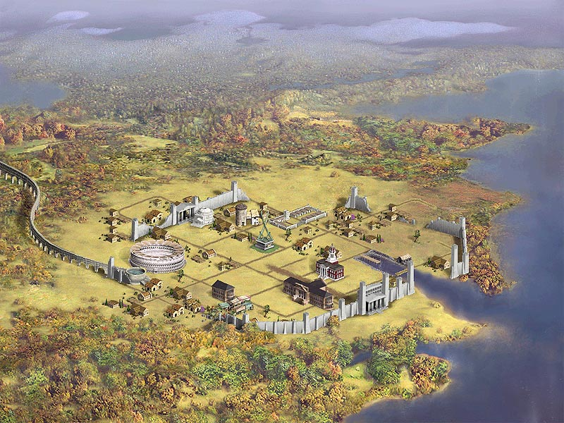
Hardcore gamer influences

Slide 5
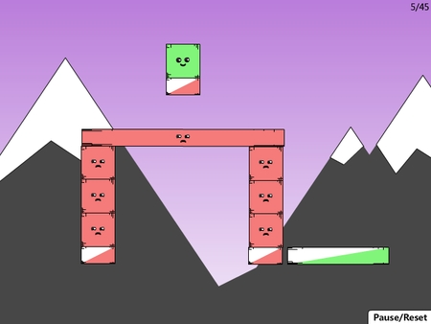
Larger always better?
>

Slide 6

How I learned to stop worrying and love the bomb

Slide 7
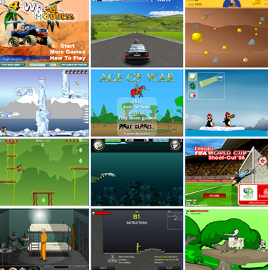
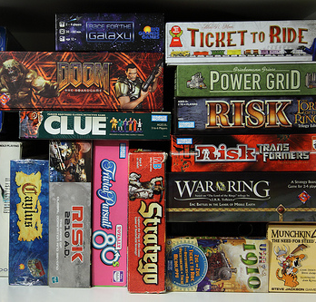
How I learned to stop worrying and love the bomb
New experience with lots of Flash games and board games

Slide 8
Small scale game advantages
Have to grab attention quickly
Offer playing process immediatelly
Easy to learn
Replayability
Early feedback

Slide 9
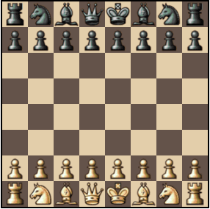

What is a game?
Story sucks
No exploring
No cinematics
Outdated graphics
POOR!

Slide 10

What is a game?
Interesting choices in dynamically developing environment
GREAT!

Slide 11
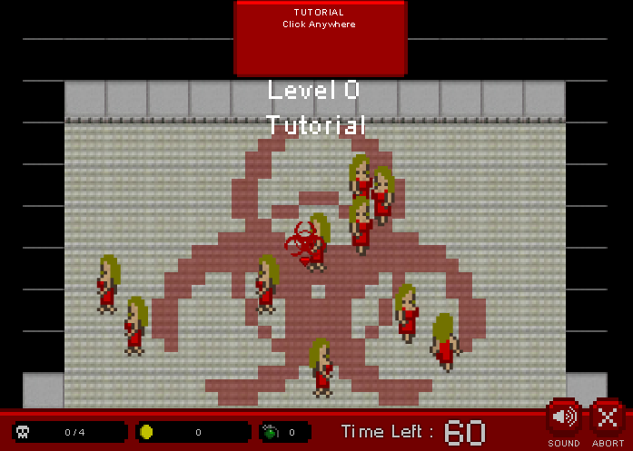
Small scale game advantages
Easy to focus on and experiment with game mechanics

Slide 12
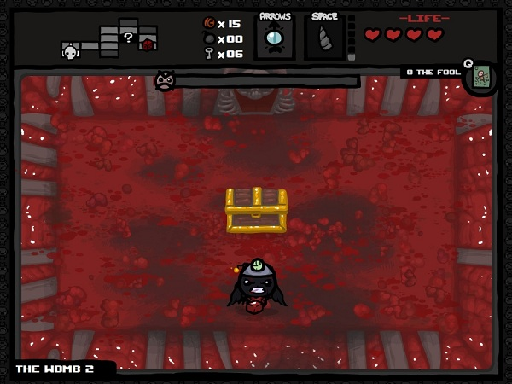
Small scale game advantages
Format limitations and technical boundaries force you to think creatively

Slide 13
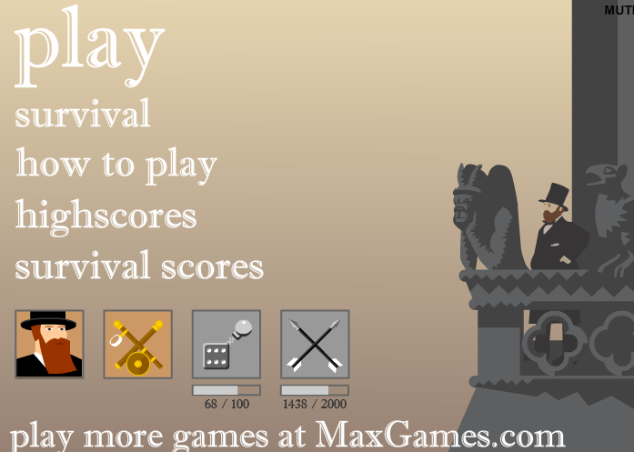
Case study – Gentleman vs Gargoyles
Wanted to make a Flash game
Did not have programming skills (any)

Slide 14
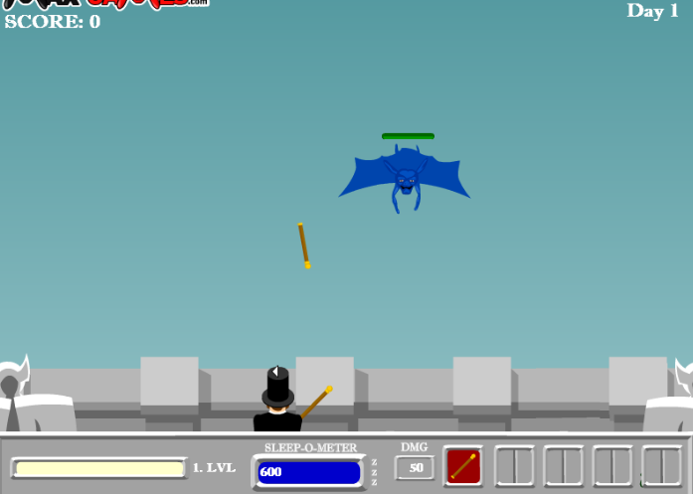
Case study – Gentleman vs Gargoyles
Very simple main game mechanics

Slide 15
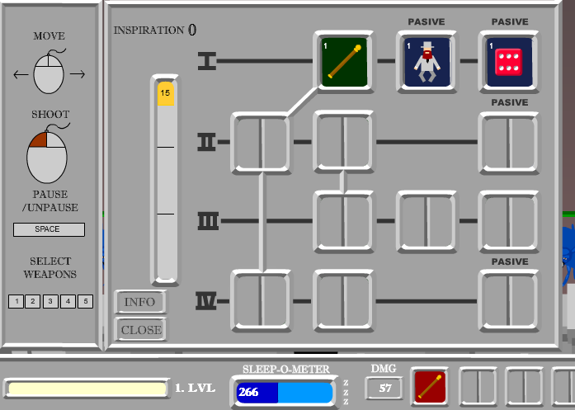
Case study – Gentleman vs Gargoyles
Interesting RPG mechanics and balanced weapons and enemies

Slide 16
Case study – Gentleman vs Gargoyles
Spent 3 months developing and learning to code
Sold it successfully at Flashgamelicense.com for 1400 $
Played it some weeks ago and still loved it!

Slide 17
Conclusion
The greatness of the game is not necessarily defined by it’s size
Focus on the game mechanics and decide what you really need to realize them and cut the rest

Slide 18
Conclusion
THANK YOU FOR YOUR ATTENTION!

