Slide 1


Slide 2
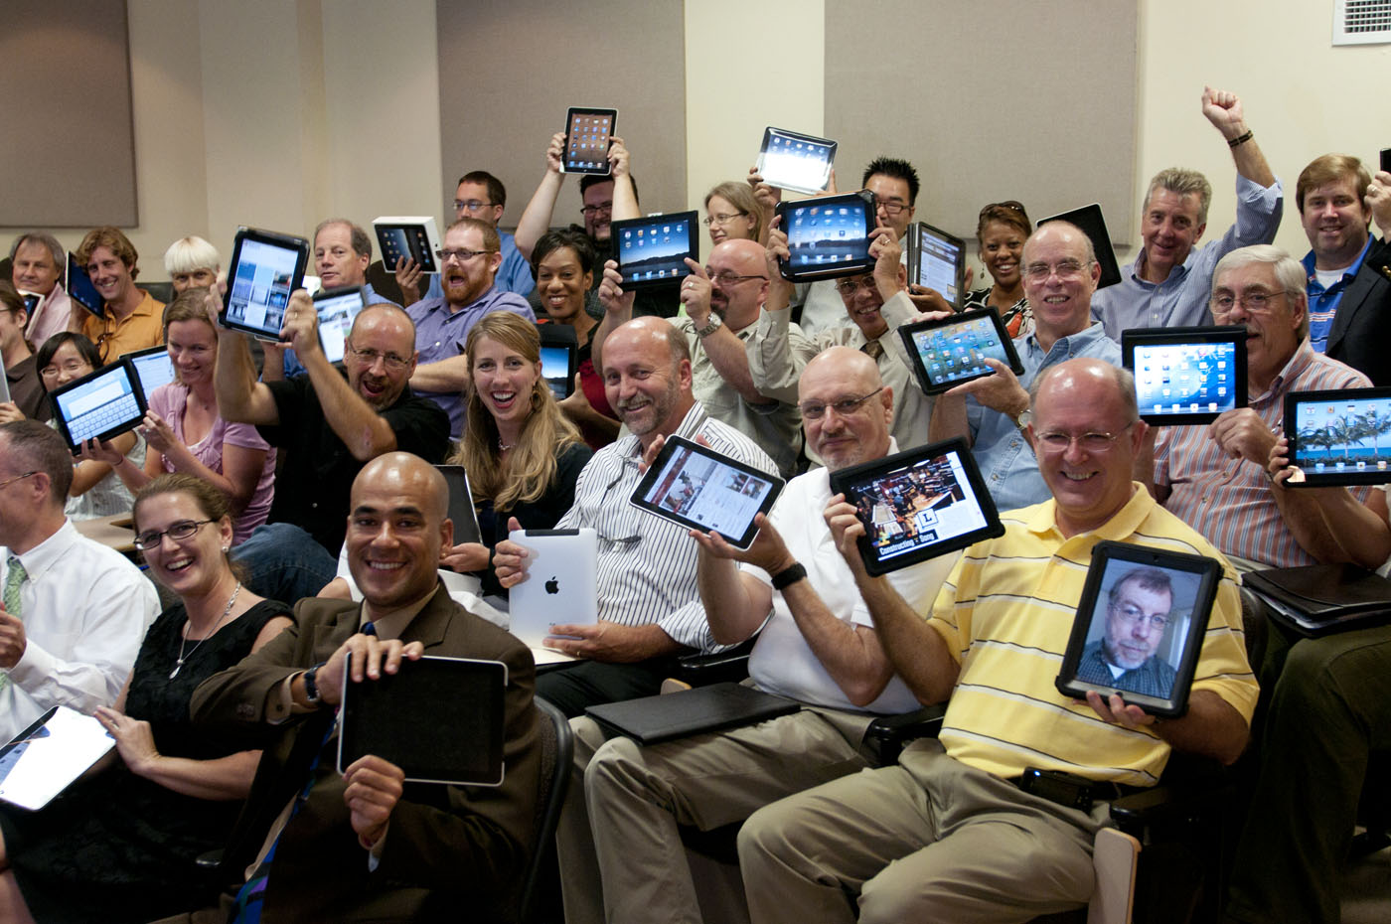

Slide 3
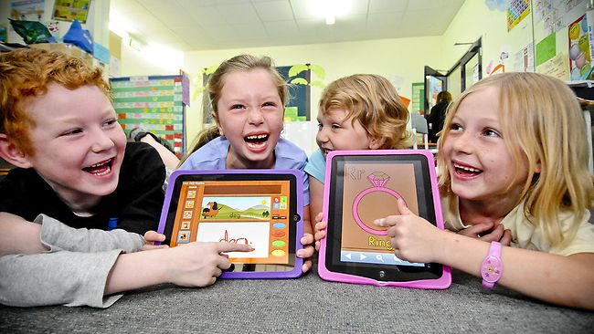

Slide 4
Games of 2012
Arithmetic: “O Labyrinth”
Geography of Latvia, scale: “O Super flyingsquirrel”
Fractions: ” O Find similars”
Chemistry: ”O Cosmic mission”
Physics: ”O Light”
Fractions: ”O Count it”
Ecosystem: ” O Big small things”

Slide 5
Arithmetic:
“O Labyrinth”

Slide 6
2 + 2 = 4
8 - 6 = 2
2 · 5 = 10
9 – 5 = 4
15 : 3 = 5
4 + 8 = 12
Simple operations
with numbers

Slide 7
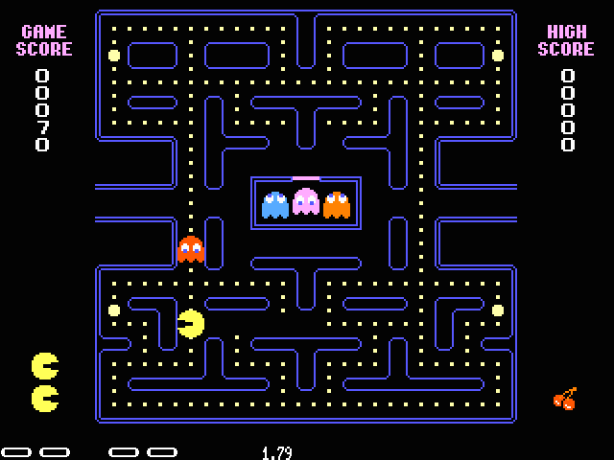

Slide 8

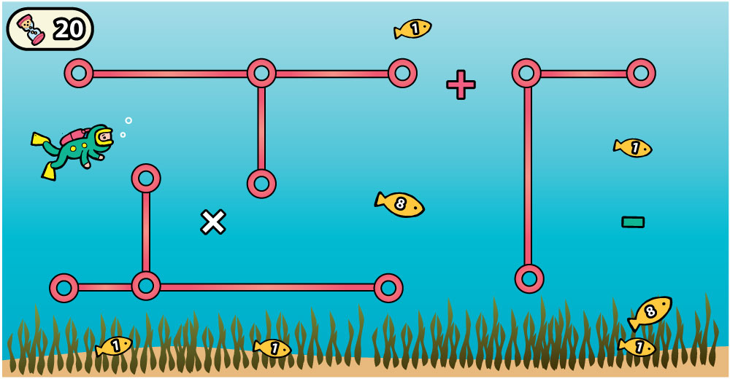


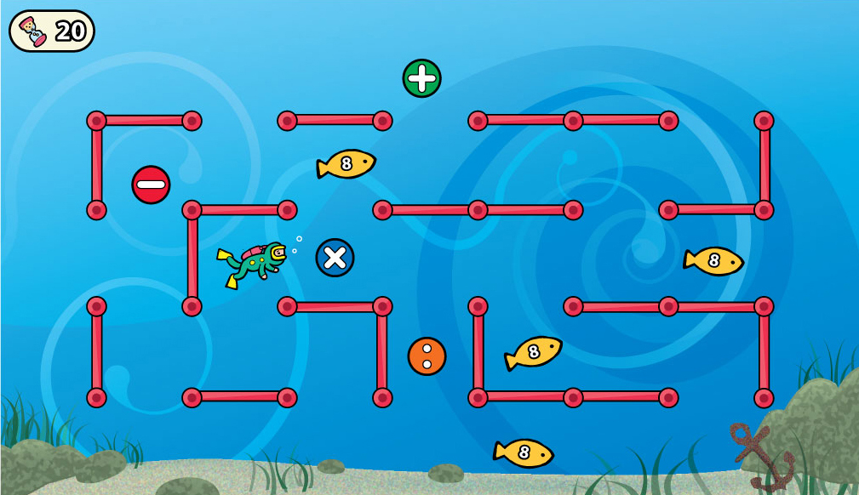



O Labyrinth

Slide 9
Geography of Latvia, scale: “O Super flyingsquirrel”

Slide 10
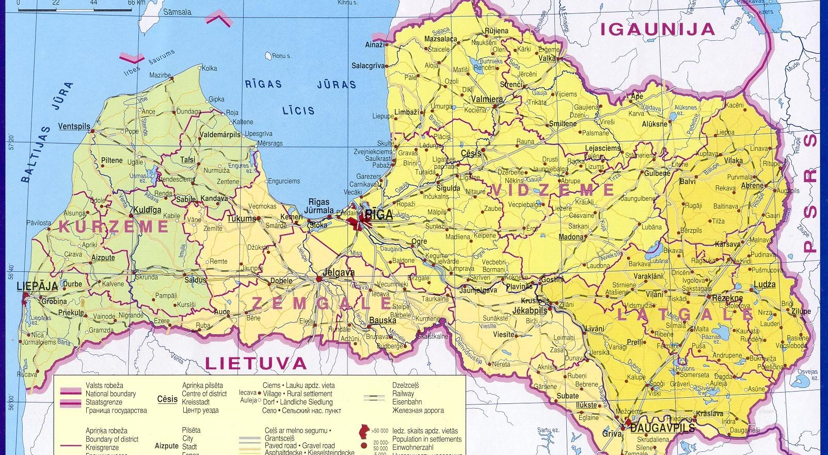

Slide 11
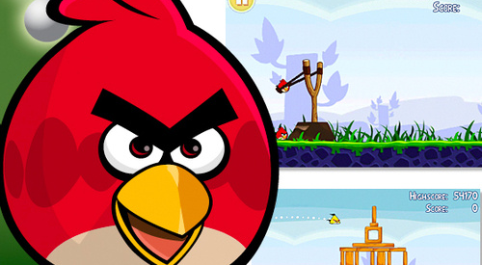

Slide 12
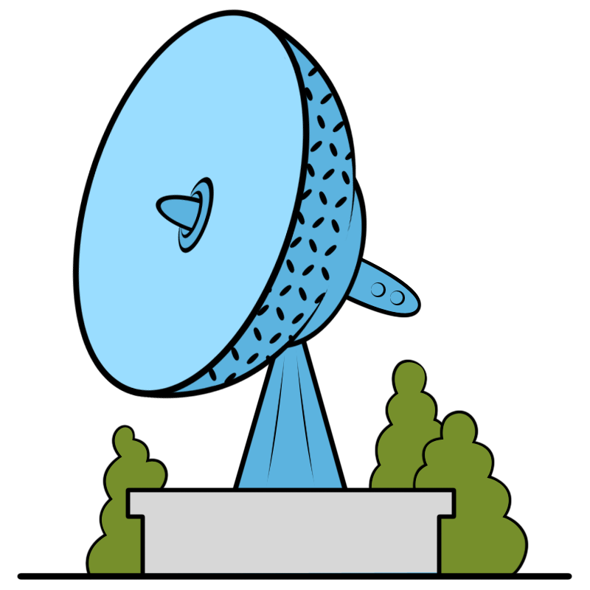
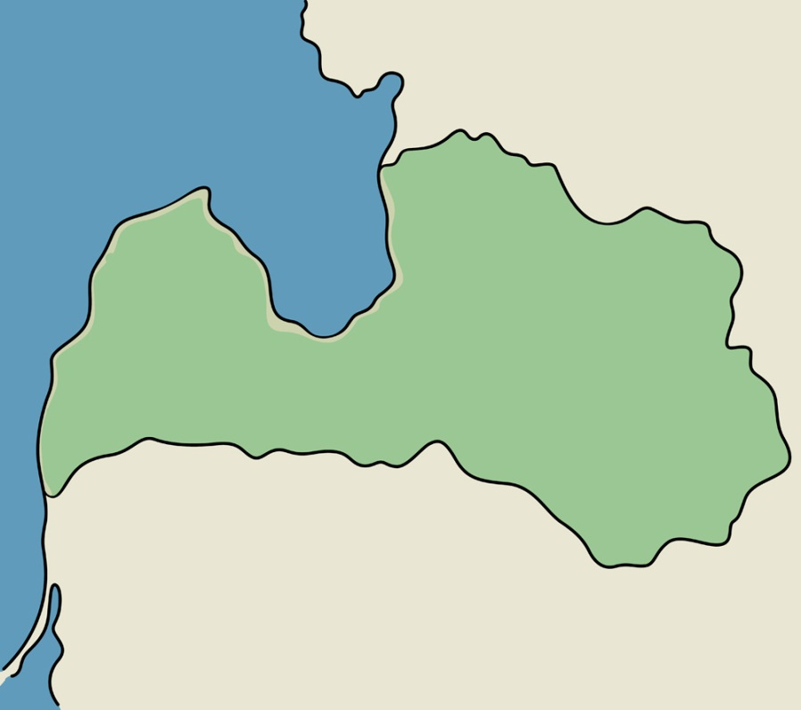
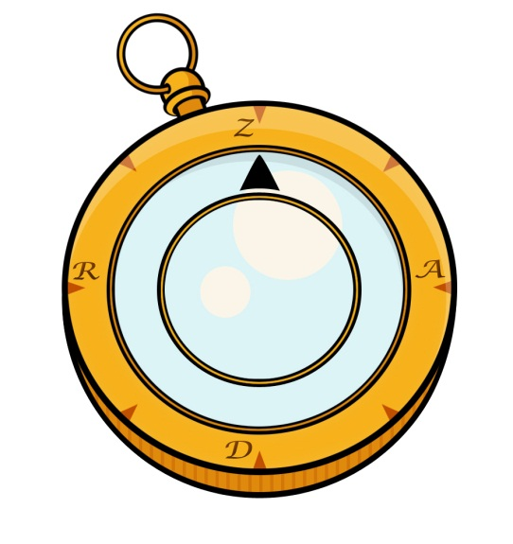
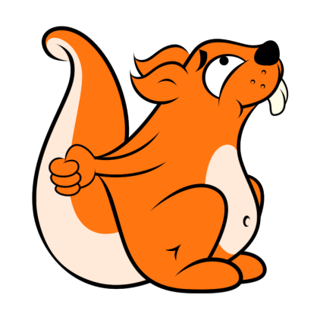
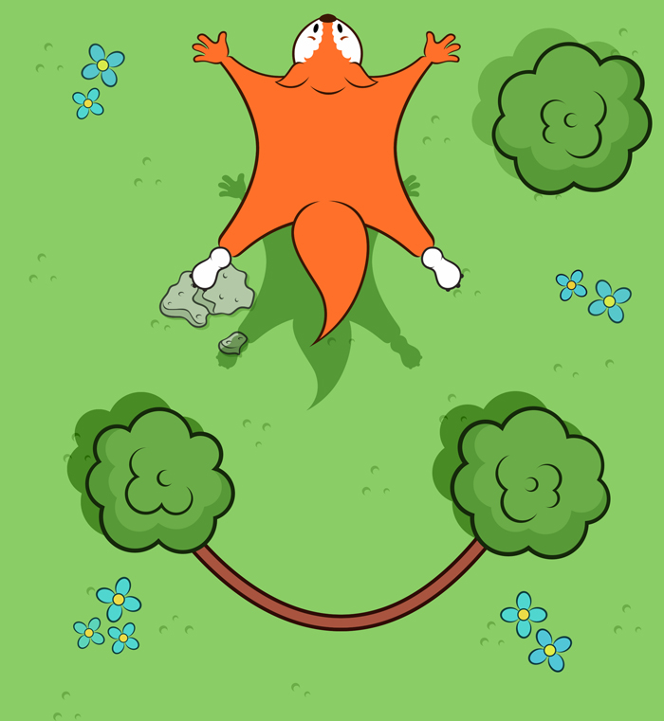
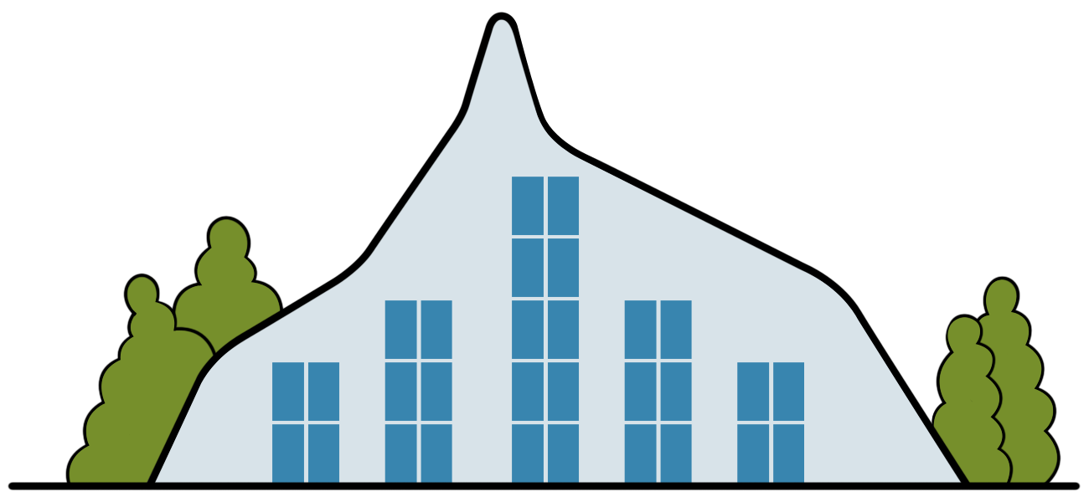
O Super flyingsquirrel

Slide 13
Fractions:
”O Find similars”

Slide 14
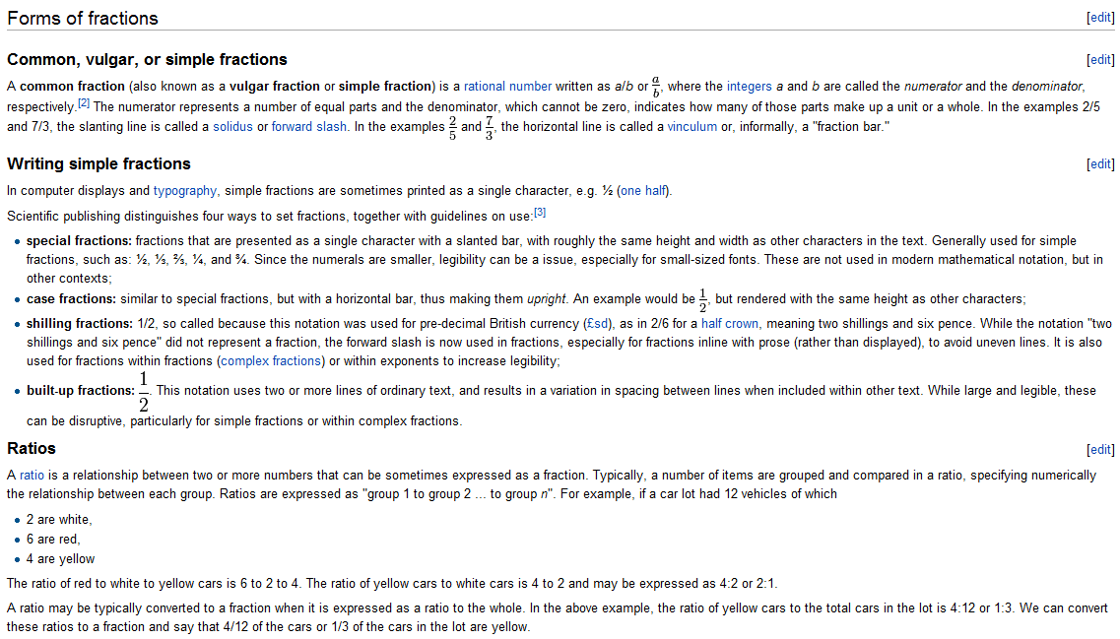

Slide 15
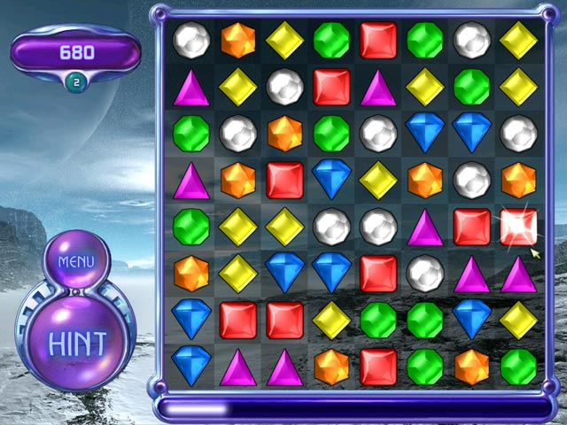

Slide 16
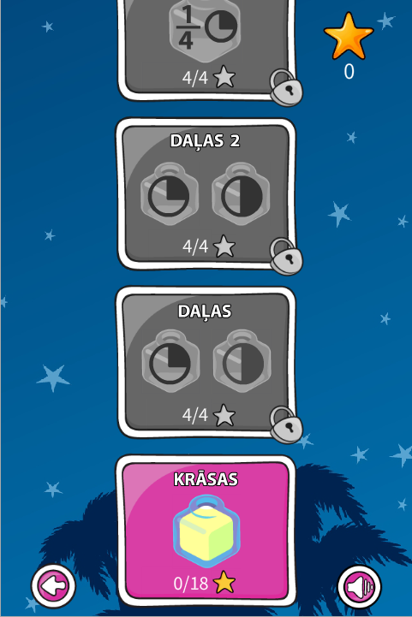
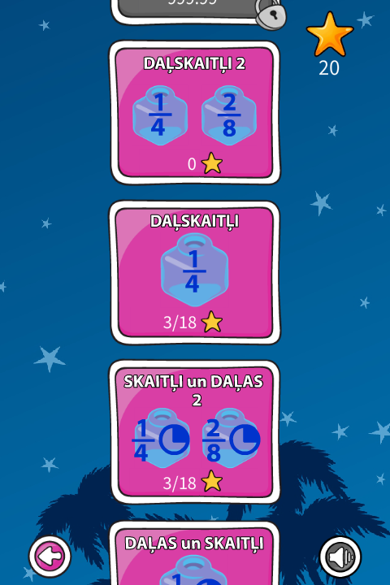
O Find similars

Slide 17
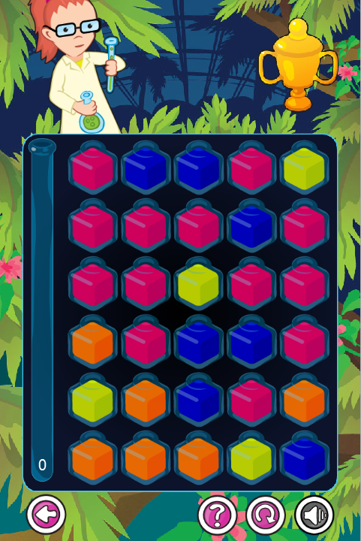
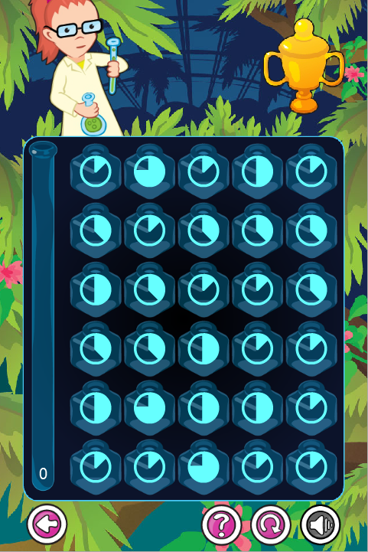
O Find similars

Slide 18
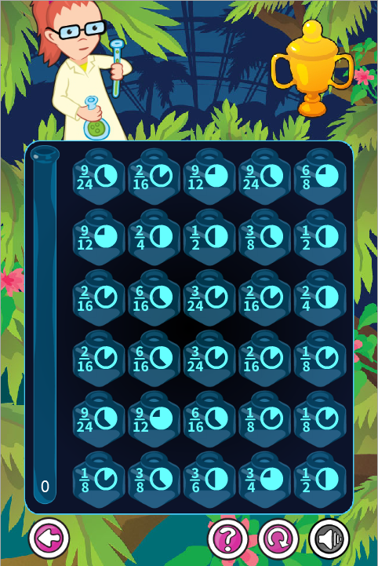
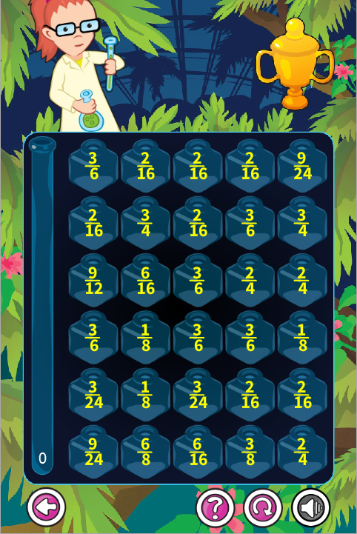
O Find similars

Slide 19
Chemistry:
”O Cosmic mission”

Slide 20
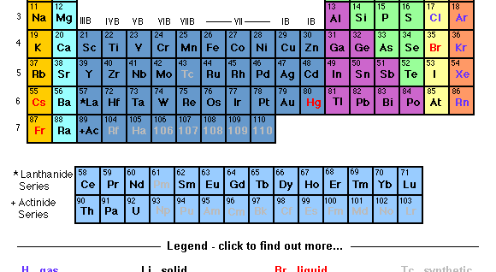

Slide 21
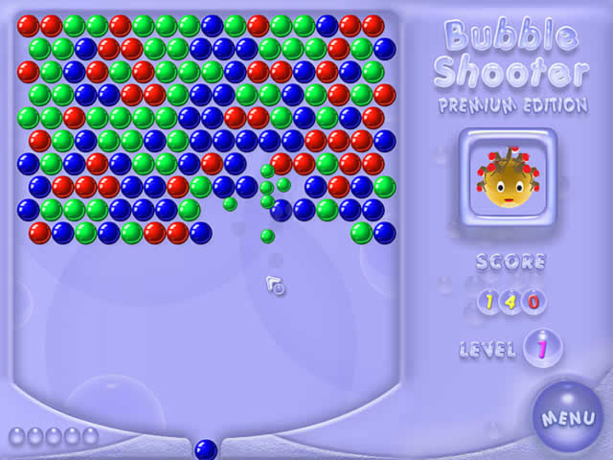

Slide 22
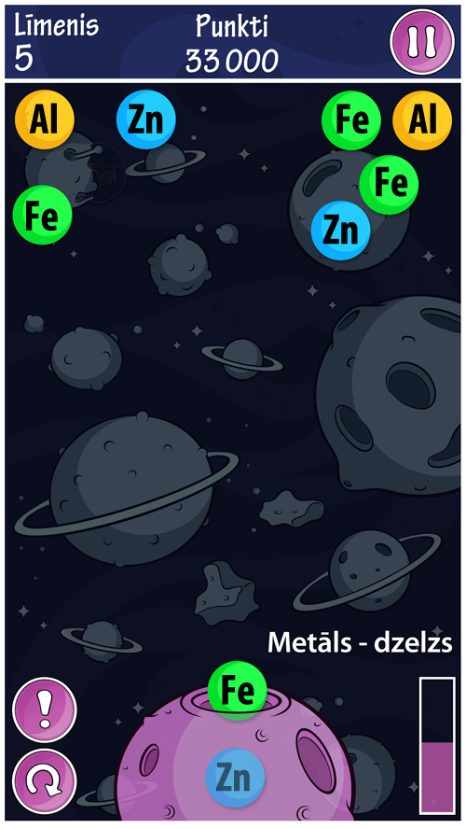
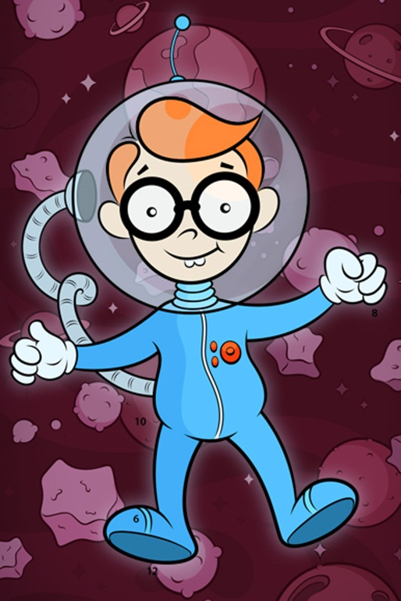
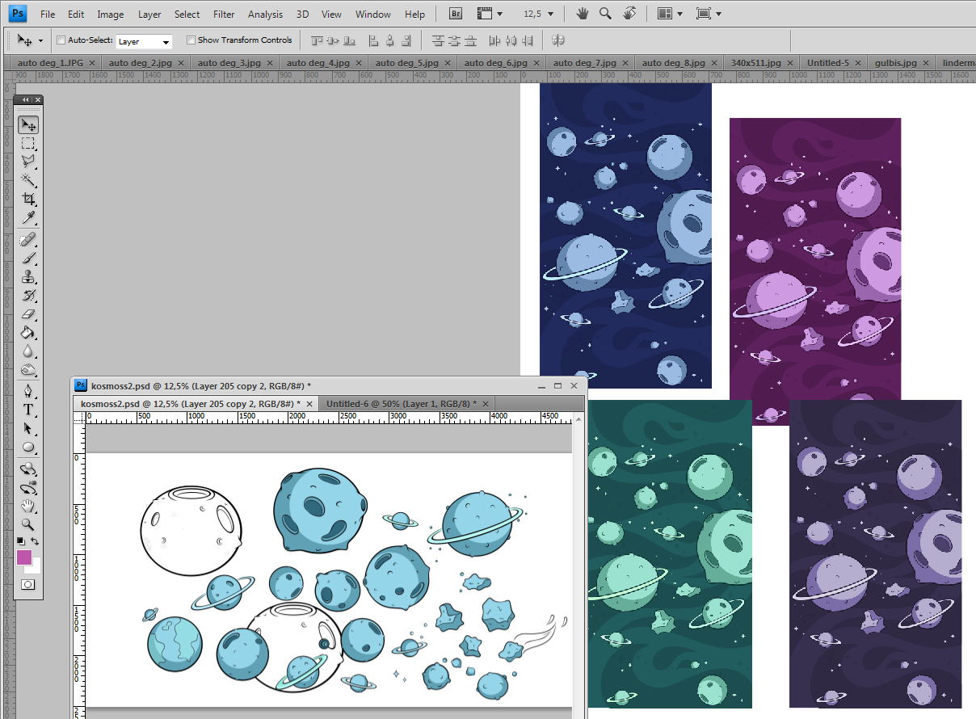
O Cosmic mission

Slide 23
Physics:
”O Light”

Slide 24
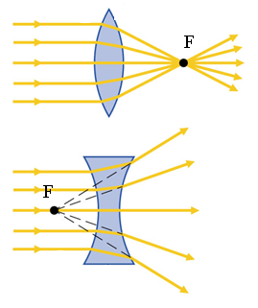

Slide 25
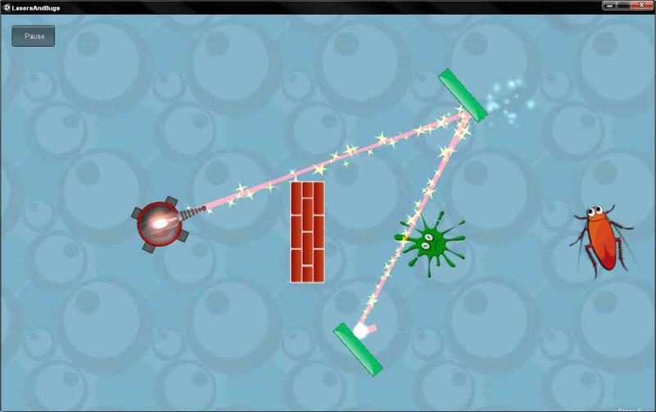

Slide 26

O Light

Slide 27
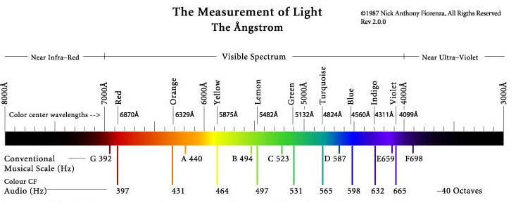

Slide 28
Where to get?
App Store
Google play
Samsung TV apps
Web (draugiem.lv, skolas.lv)

