Slide 1
Vecais labais Karogs
(The good old Karogs)
Raimonds Rudmanis
Notes:
Disclaimer
I am not professional games developer
I am not even a professional developer
It is not my job to write a code
It is my hobby
I never worked for Tilde as employee
I simply know the owners of Tilde very well

Slide 2

Notes:
How it all started…

Slide 3
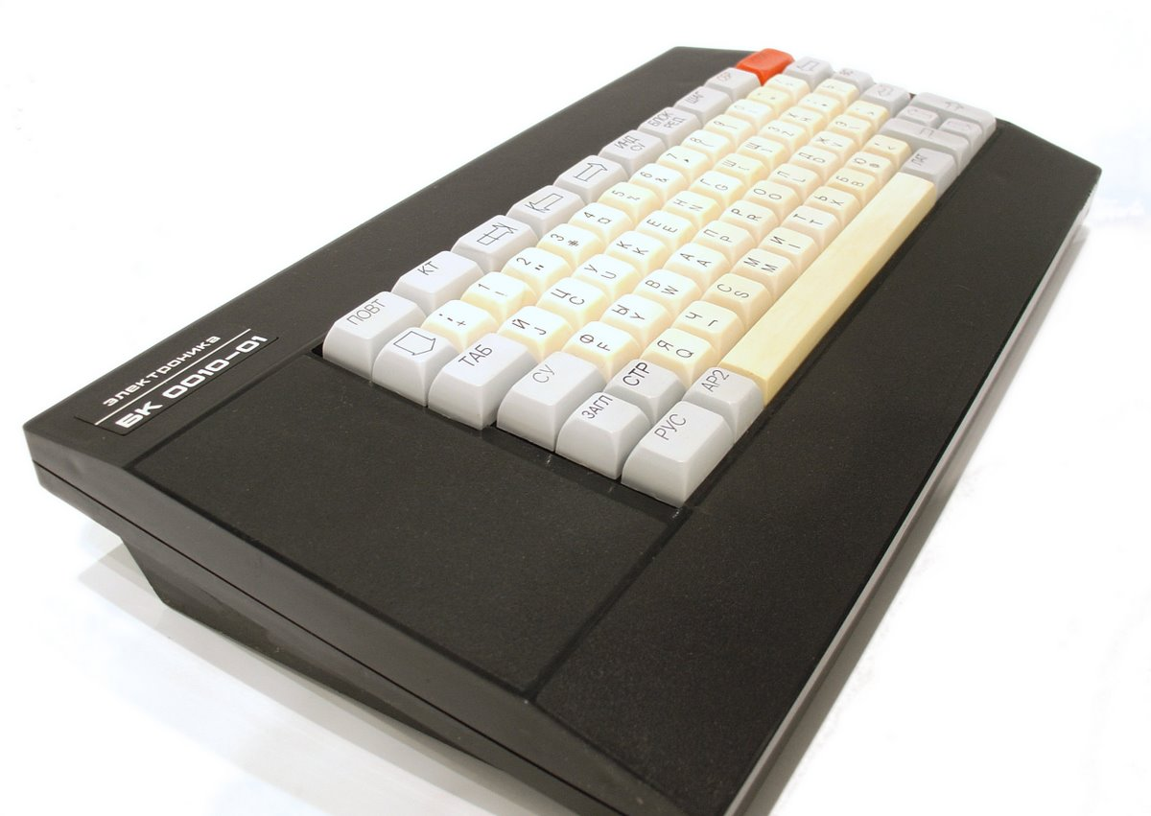
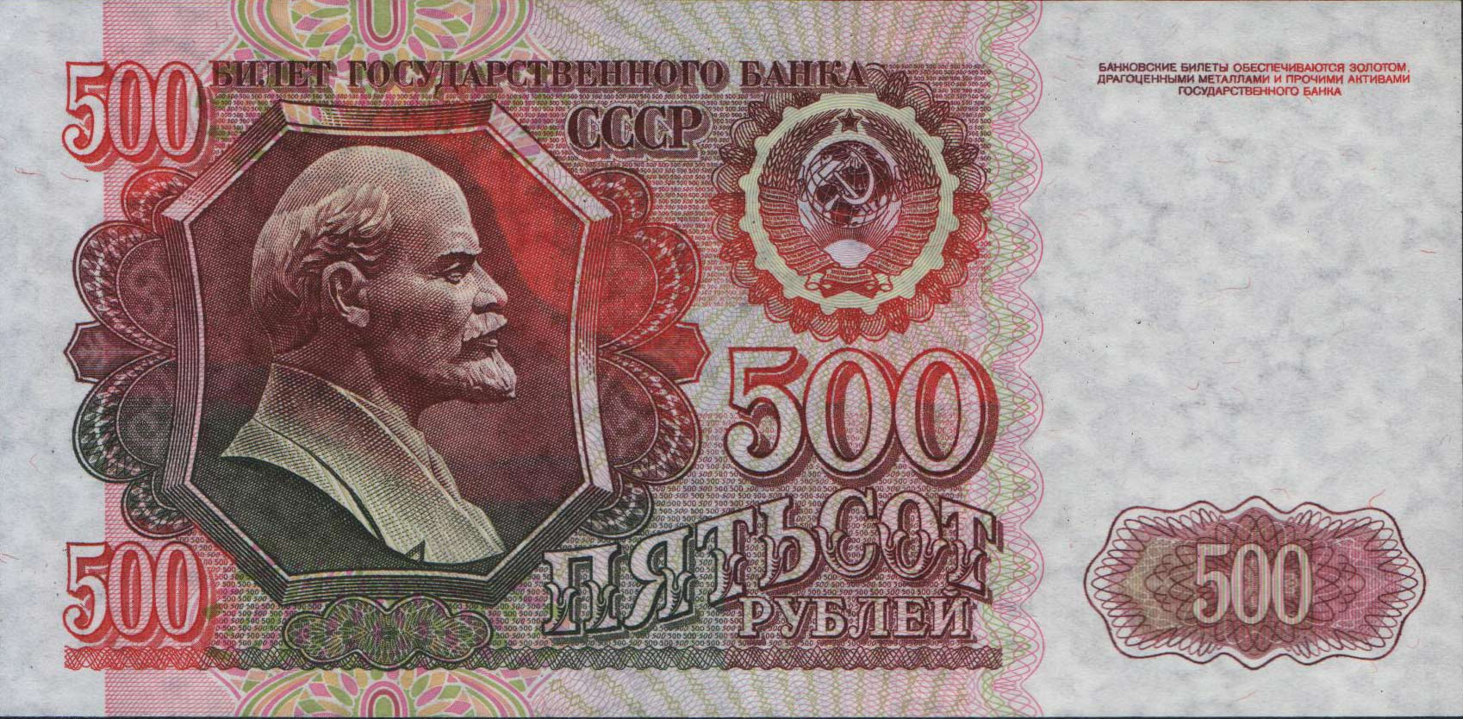
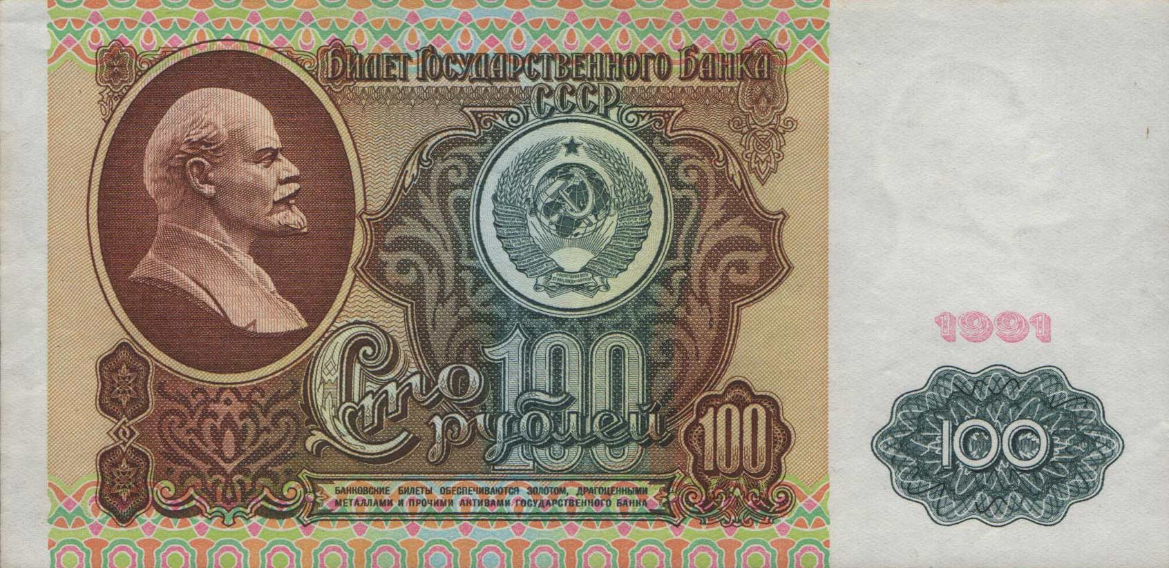
БК = ?
Бытовой Компьютер
Notes:
This is my first computer
Soviet home computer BK-0010-01
It was quite expensive - ~600 rubels
I started writing my first games
Russian abbreviation БК, which stands for Бытовой Компьютер

Slide 4
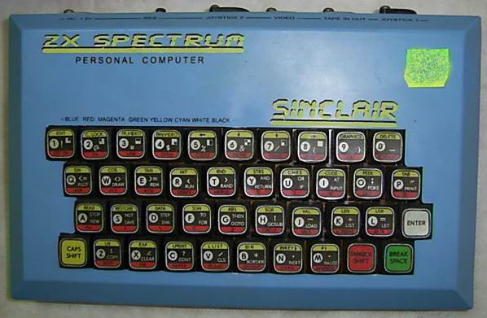
Notes:
This is my second computer
Custom made ZX Spectrum 128
Metallic tower with floppy drive and separate sound processor
ZX Spectrum clones were very popular in Soviet Union times

Slide 5
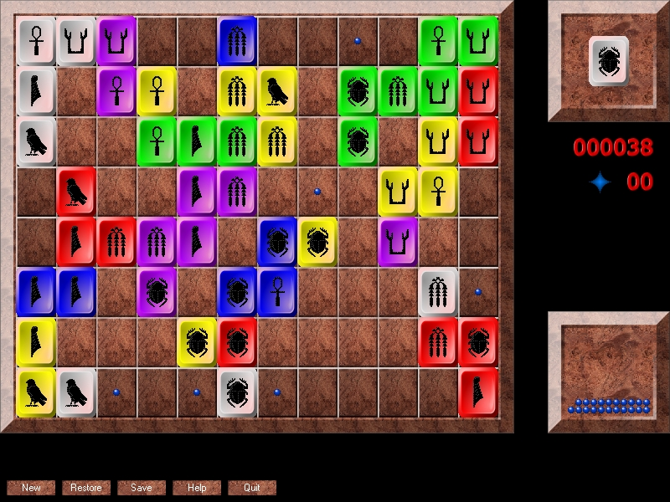
Notes:
For ZX Spectrum I made a game like this
The screenshot is from a DirectX game I created later for PC

Slide 6
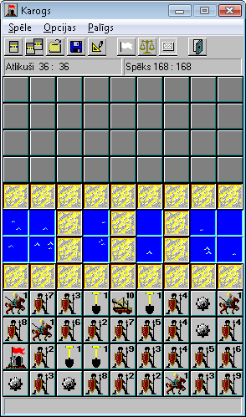
Notes:
Karogs appeared around 1995
My motivation was to learn C++ and Windows development
The game idea came from some old magazine (žurnāls Atpūta)
Initial version was in English and only later I translated it and gave it to Tilde
Graphics simply does not exist, but the gameplay was quite addictive

Slide 7
Technologies
C++
16-bit, 32-bit
Windows API
Windows graphics device interface (GDI) API
Custom AI (shallow minimax search, pathfinding, evaluation function)
Windows Sockets (winsocket)
Notes:
AI is definitely not the best, but it is fast and does not consume too many CPU cycles

Slide 8
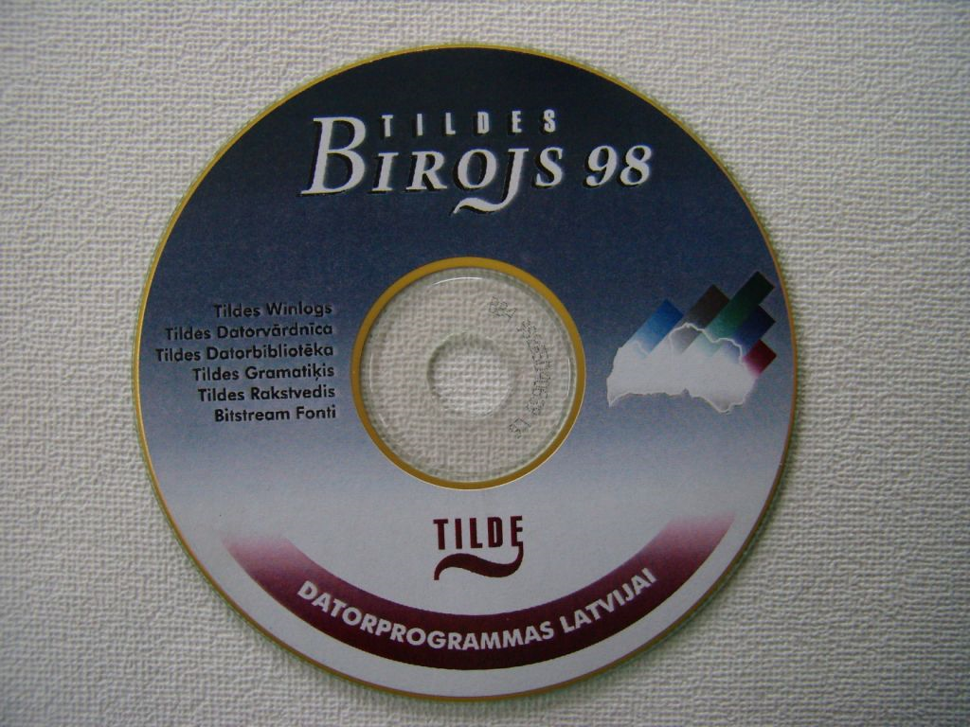
Notes:
Tilde had a good lobby with public sector and education sector
On almost all computers Tildes Birojs was installed
Karogs and Lingo were quite popular because they were the only games people had on their computers besides Solitaire and Minesweeper
Many people even today still believe that Karogs and Lingo is part of Windows operating system

Slide 9
«Karogs ir ideāli piemērots, lai kļūtu par mobilo aplikāciju un arī mūsu bērni izbaudītu šo Latviešu stratēģisko šedevru. Labprāt šķirtos no pāris € par šo spēlīti»
«Tildei ir 2 labas programmas: Karogs un Lingo. Pārējais uz Recycle Bin»
«Ouu, vot šitā ir štelle, 10 gadi atpakaļ, kad tiku pie pirmā PC, atvedu mājās, sastellēju un uzgāju šo spēlīti, līdz 3 naktī viņu rukāju, toreiz likās nekas labāks nav iedomājams…»
«Viena no visu laiku labākajām latviešu stratēģijas spēlēm»
«Diemžēl nelietoju tildes biroju, taču ļoti gribētu uzspēlēt spēli "Karogs". Vai to iespējams iegādāties atsevišķi?»
«Atceries, šī spēle rada atkarību»
«Nostaļģijas mākts atcerējos par šo kādreiz tik aizraujošo spēlīti»
«Sen nav spēlēts tildes karogs tīklā. Nostaļģija....»
Notes:
Some quotes from Internet forums and discussions

Slide 10

Notes:
Some people even made the jokes like this

Slide 11
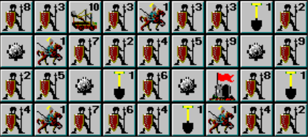
Graphics for the Karogs units were actually stolen from some popular strategy game for PC.
Sid Meier's Civilization

Slide 12
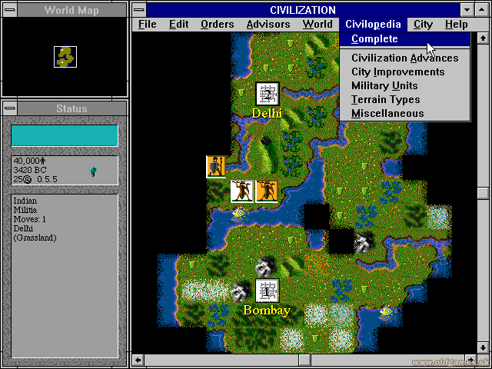

Slide 13
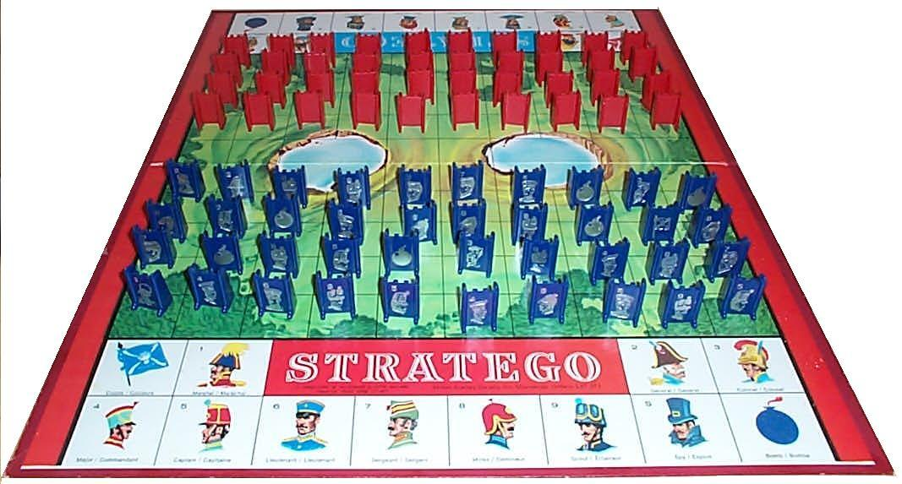
Notes:
Board game Stratego with similar rules
It is well known game, especially in USA
Many people remember it from their childhood

Slide 14
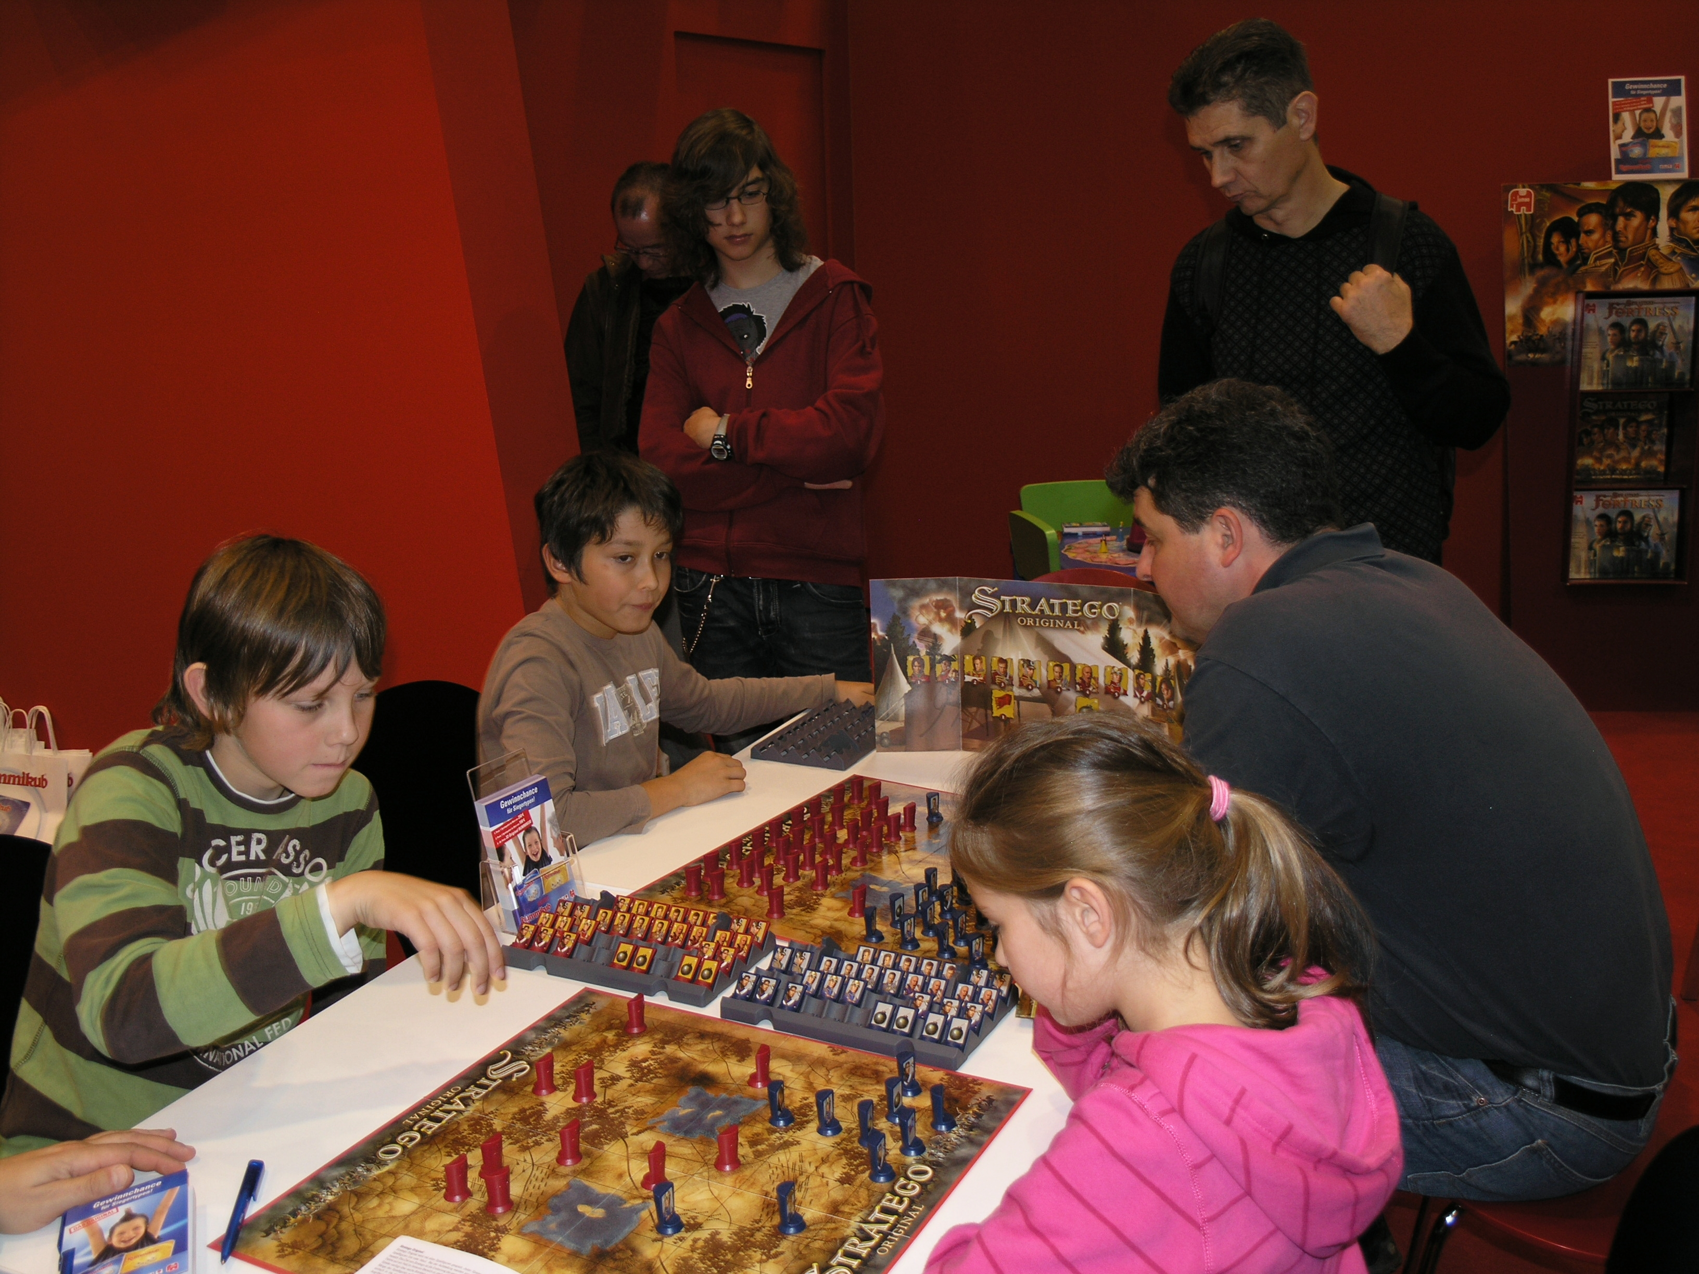
Notes:
Championships, federations, associations

Slide 15
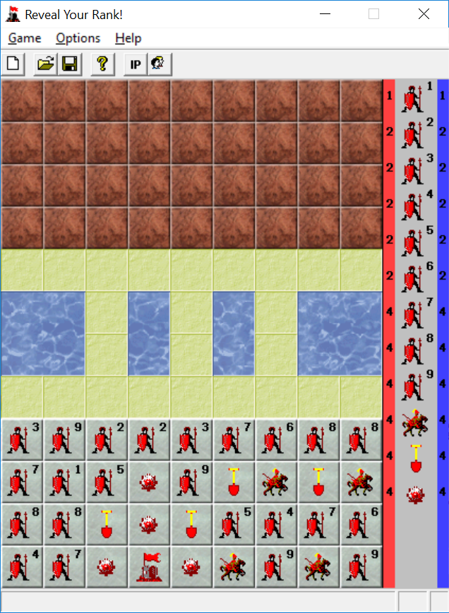
Notes:
The next incarnation of Karogs - Reveal Your Rank!

Slide 16
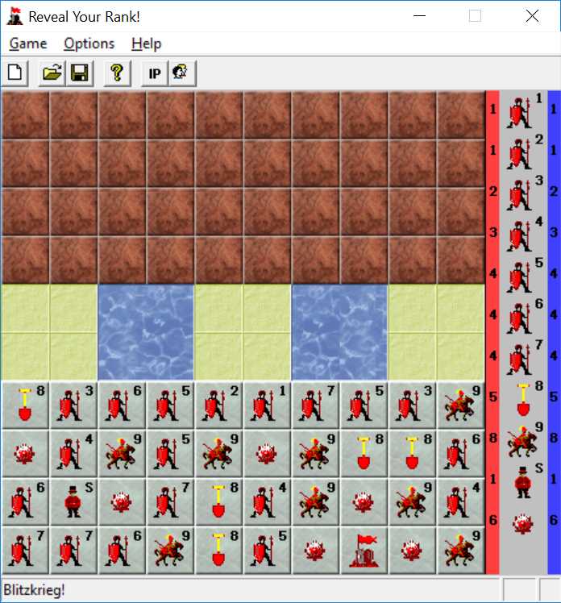
Notes:
With Stratego rules

Slide 17
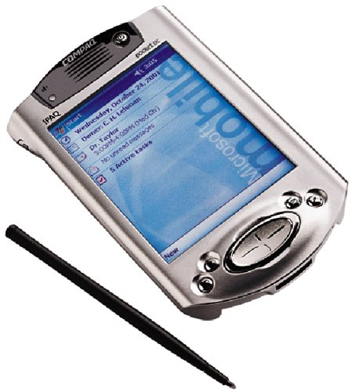
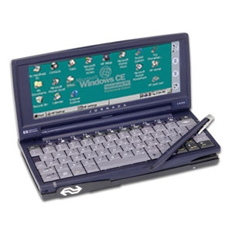
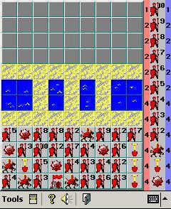
Notes:
Personal digital assistants
Reveal Your Rank! for different devices - Pocket PC and Handheld PC

Slide 18
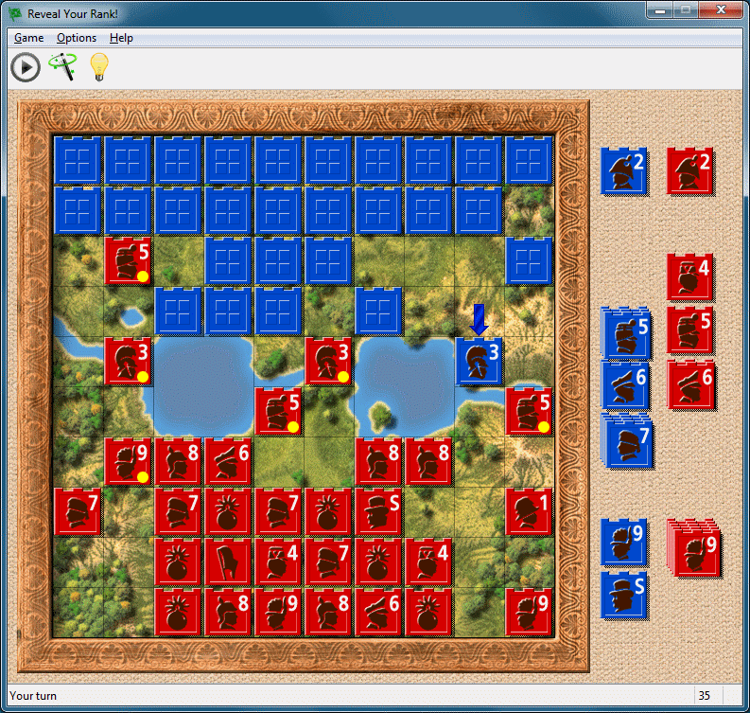
Notes:
The latest version of Reveal Your Rank!
Some designer from Latvia made me the graphics (Andris Gailītis)

Slide 19
Demo

Slide 20

Notes:
Karogs is not dead yet…

Slide 21
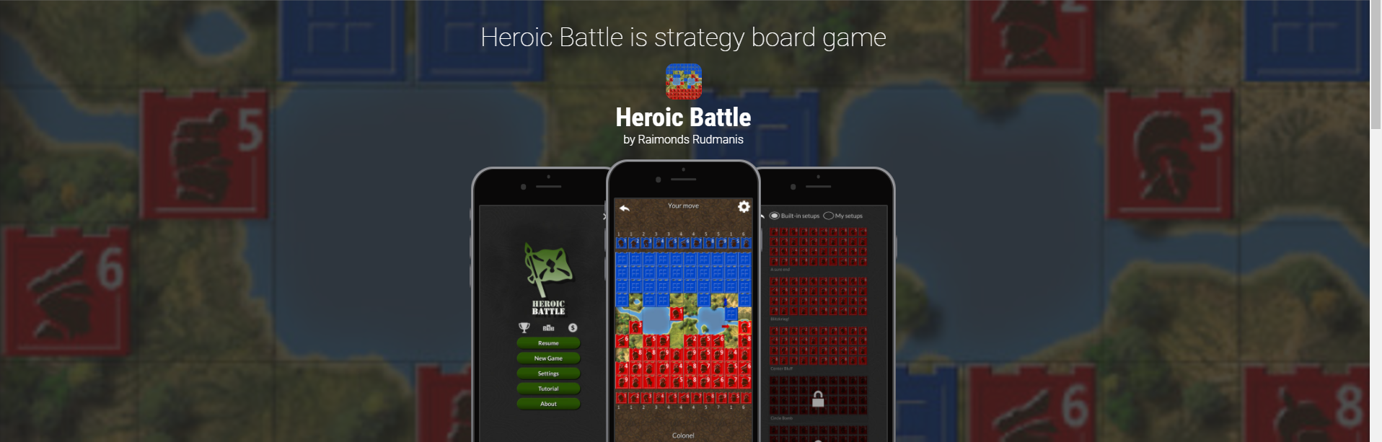
Notes:
This is the latest incarnation of Karogs – Heroic Battle

Slide 22
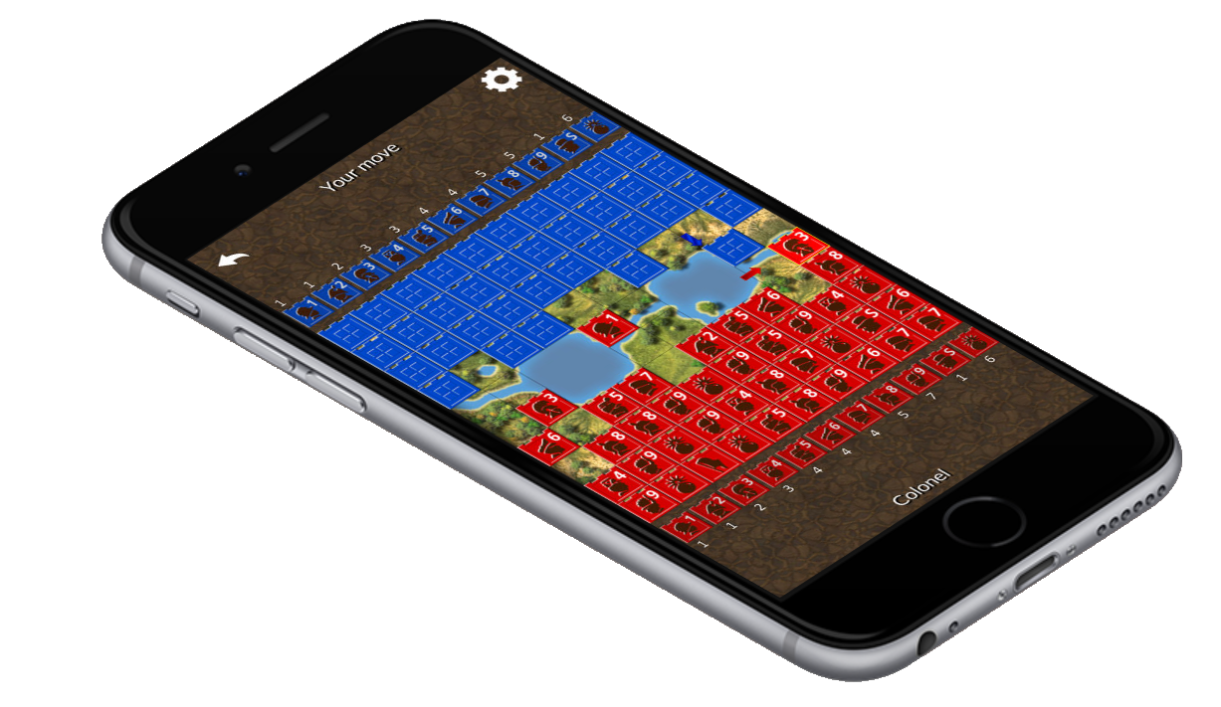
Heroic Battle
Notes:
Available in AppStore, GooglePlay, Windows and Amazon

Slide 23
Technologies
Unity game development platform
C#
Assets from Unity assets store, e.g. Gamestrap UI
Google AdMob (mobile ads)
Unity IAP (in-app purchase)
Unity Analytics
MacinCloud service for building iOS code

Slide 24
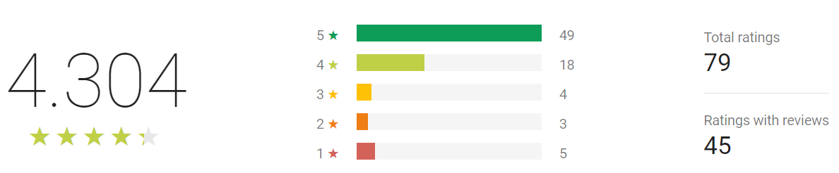

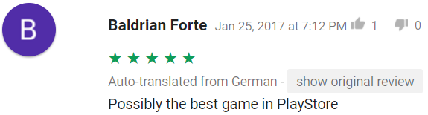
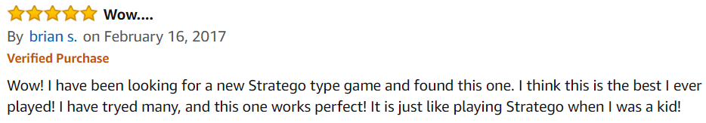
Notes:
Overall people are quite happy with the game

Slide 25




~11 311 downloads
~1 620 downloads
~166 downloads
~144 downloads

Slide 26
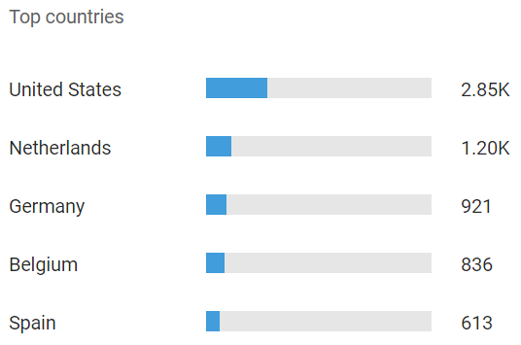
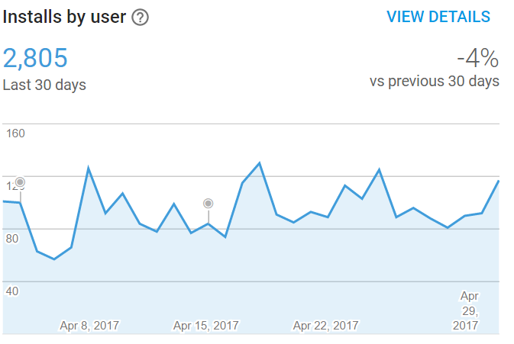
Notes:
Peeks on Sundays

Slide 27
Games development today
Telemetry, analytics
Cross-platform engine
Different screen sizes and resolutions support
Asset store
Early feedback
Frequent releases
Notes:
2 different layouts for Portrait and Landscape

Slide 28

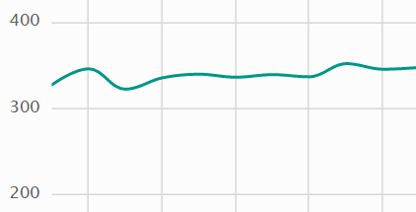

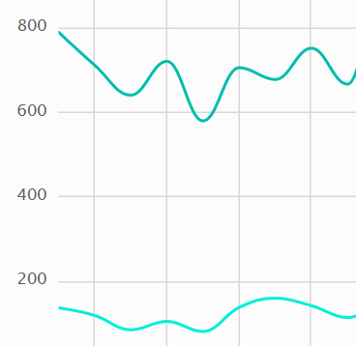
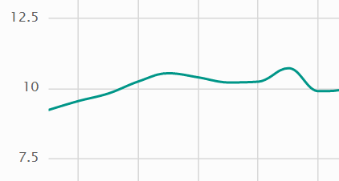
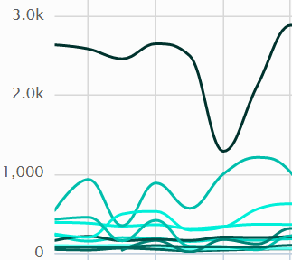
Unity analytics
Average number of moves per game
Average time per game
(10K seconds = 2.8 hours)
Wins vs losses
Achievements

Slide 29
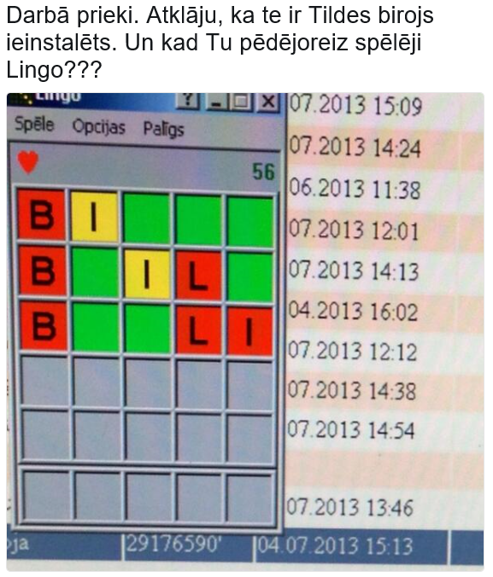
Notes:
Lingo is a word game
I have a few stories about the Lingo game as well

Slide 30
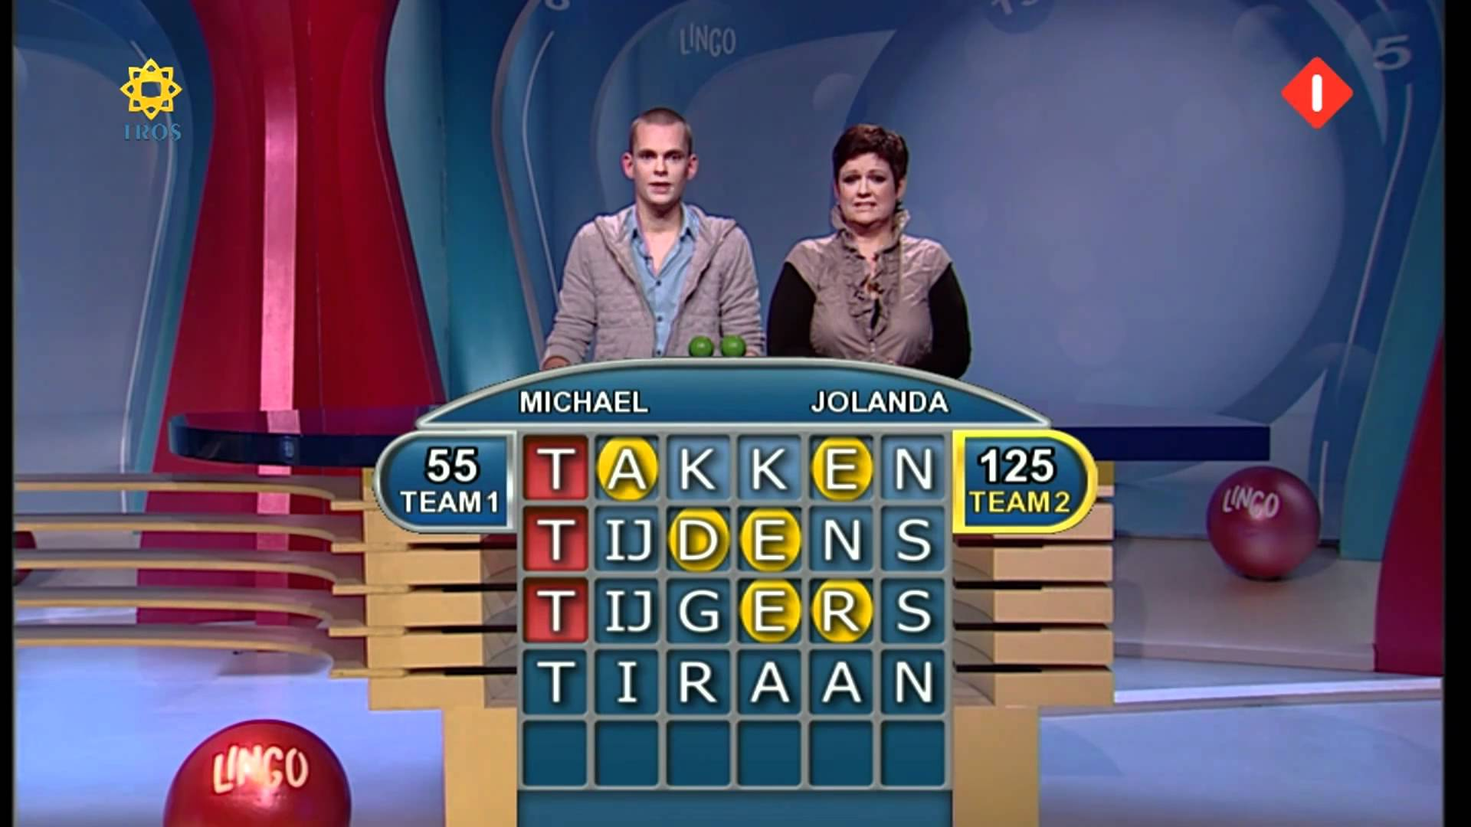
Notes:
Influenced by TV show with the same name
I had a business trip and in hotel I saw the show
Initial version of Lingo was made in 1 day

Slide 31
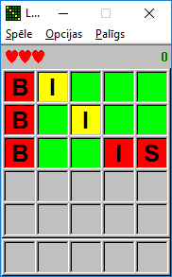
Notes:
Collection of words I got from Latvian spellchecker
Program, which enumerates all possible words and collects only the valid words

Slide 32
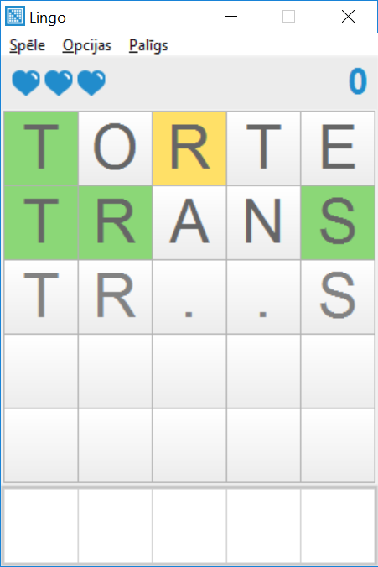
Notes:
At some point I completely lost a source code of Lingo
Lingo was rewritten again completely from scratch in 2013 (included in Tildes Birojs 2014)

Slide 33
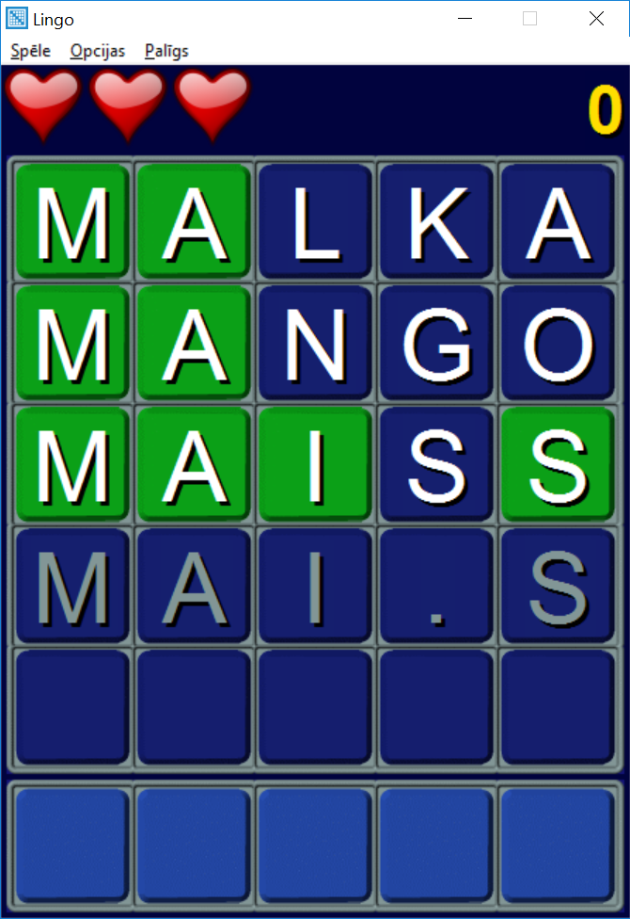
Notes:
Different skin

Slide 34
goo.gl/FC6YKb
Notes:
Lingo download link

Slide 35
Questions

